Slide 1

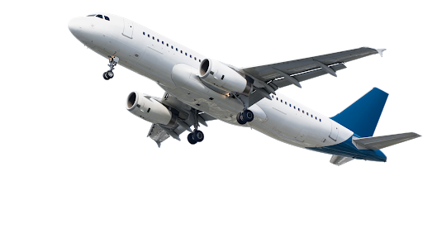
Real Time System Final Exam Project
Présenté par : Mlle.Charhabil Sanaa Encadré par: Mr.F.kharroubi

Slide 2
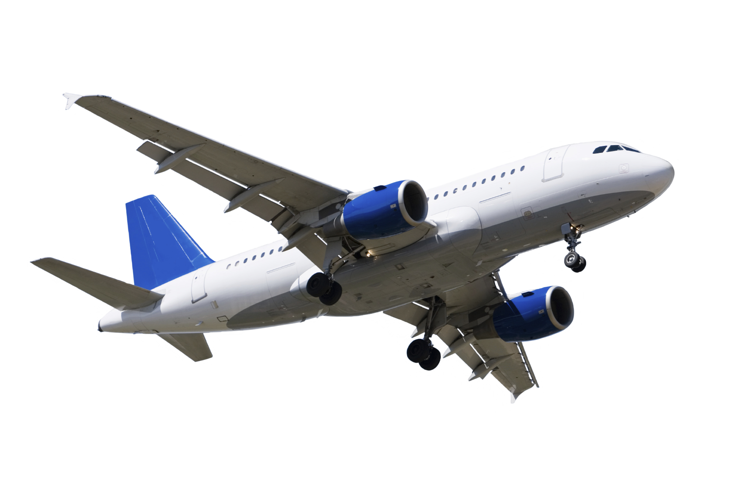
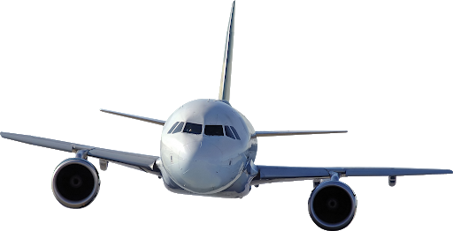

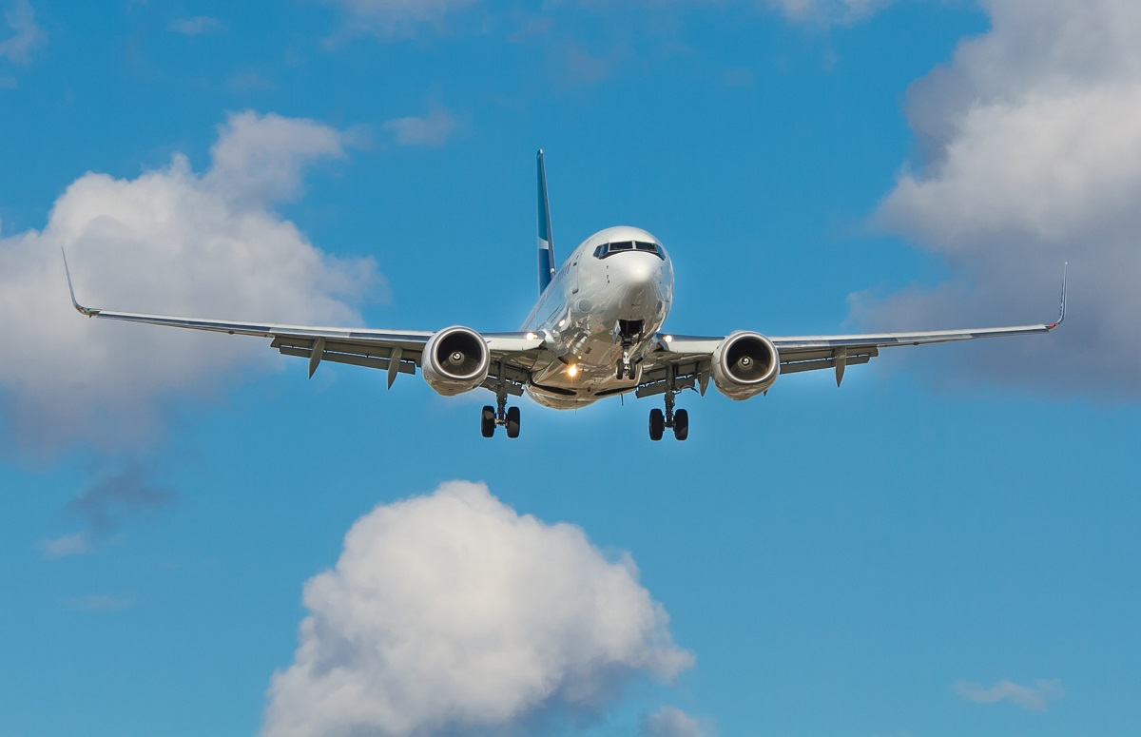
Introduction – Aim of the Project :
The objective of our project is to create software and develop a
mini-real time Flight Mini Simulator.

Slide 3
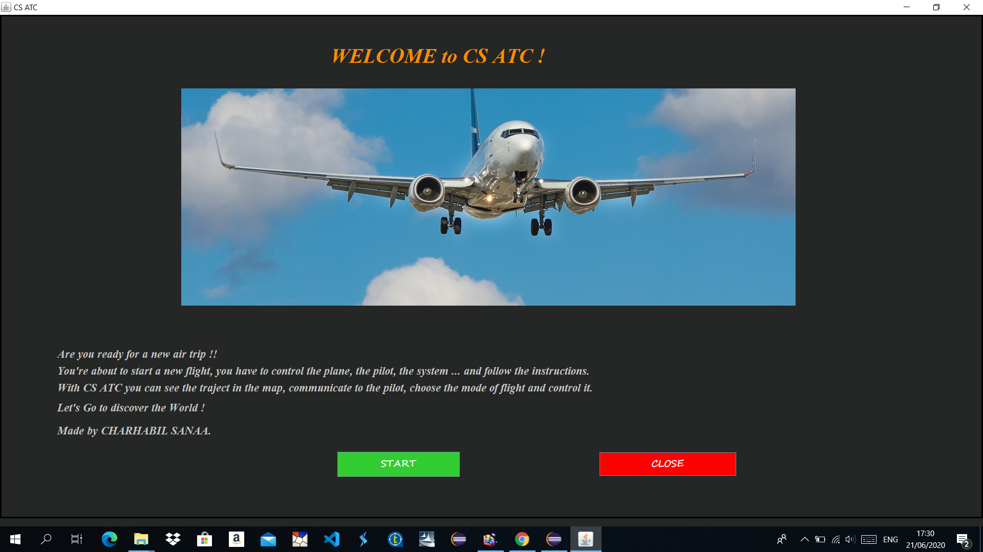
Welcome to CS ATC :
Here is the first interface that we be shown if we launch the Class Welcome !
It contains instructions and a button to start.

Slide 4
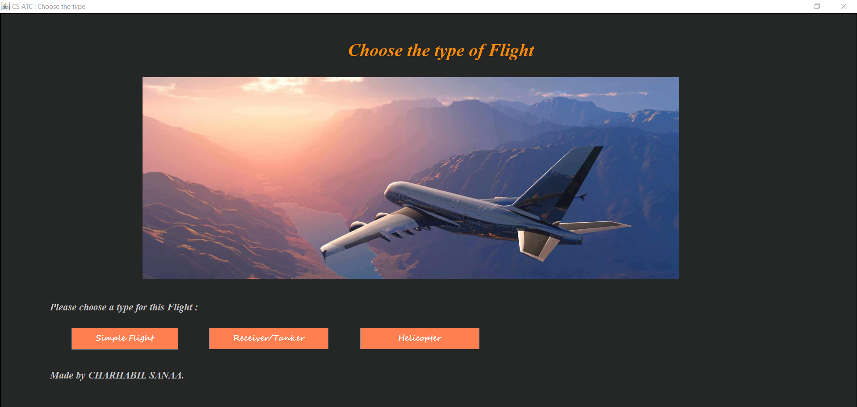
Choose the type of flight !
This second interface of our software, let the pilot choose the type of flight that we wants to start : Simple Flight, Receiver/Tanker, Helicopter …

Slide 5
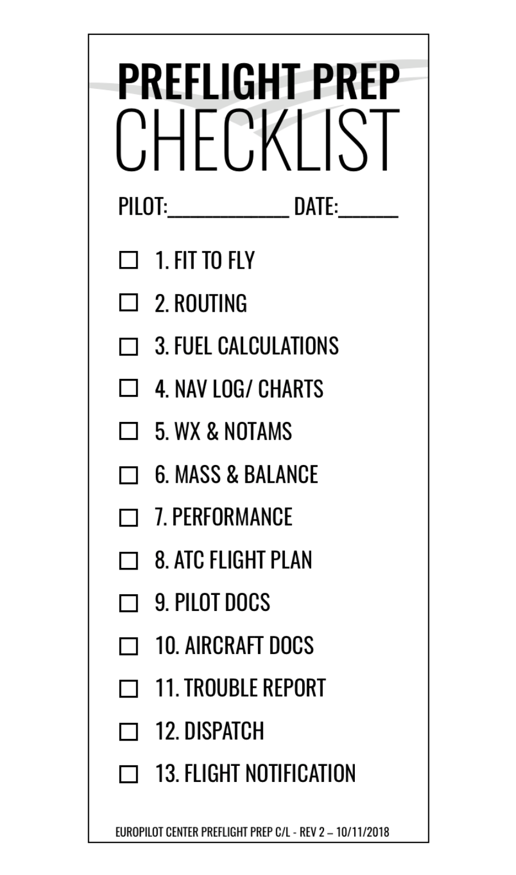
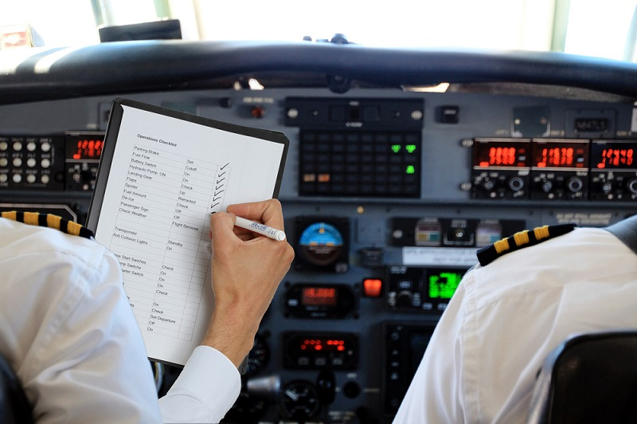
Checklist for The Pilot – WARNING !
Before starting the flight, the pilot must make sure that all works well on the plane, by checking a list which contains instructions.

Slide 6
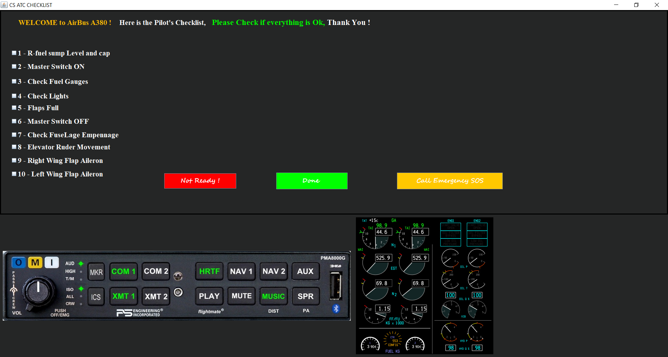
CS ATC Checklist for The Pilot – WARNING !
Here is our checklist, of course it shows the instructions to follow, but also if the pilot does not check them the flight cannot start. I also added a button to call the SOS emergency at any time.

Slide 7
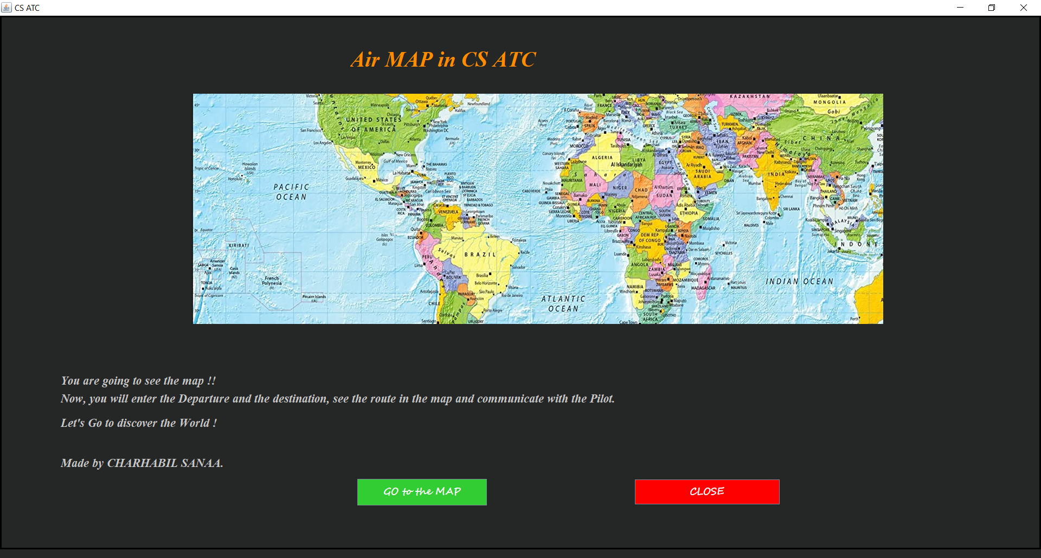
Go to the Map – Index :
If the pilot completes the checklist and everything is fine, then he can start his flight, specifying on the Map the point of departure and the point of arrival in order to see the route.

Slide 8
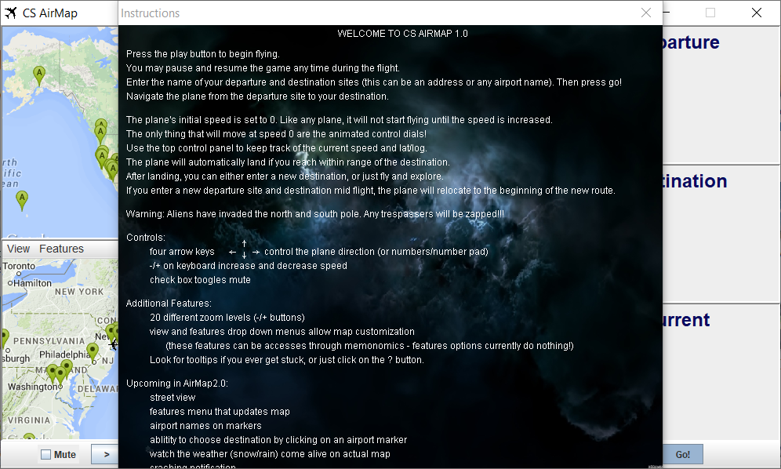
CS AirMap instructions– WARNING !
An instruction interface appears before viewing the map, we have to close it and continue.

Slide 9
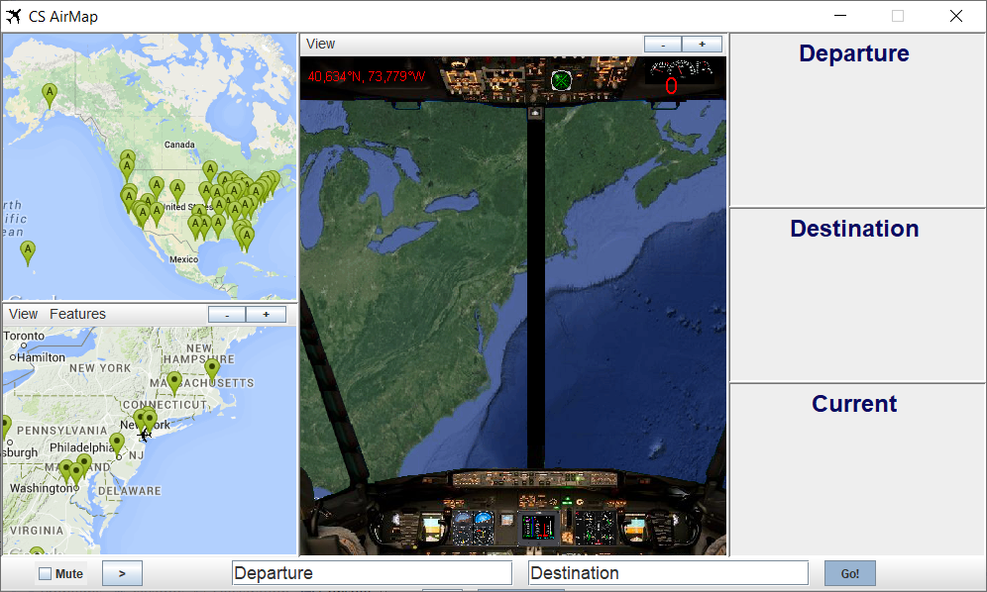
CS AirMap – Cards and inputs
So here is the interface that will present our journey, we can see in the central image our position.
The other interfaces are maps, the first, at the top, presents and identifies the airports close to our position and the second, presents our plane via a symbol as well as the other planes which are close to them.
And at the bottom, the pilot must insert the Departure and the Destination.

Slide 10

Enter the Departure & Destination of the Flight :
We entered Paris as a Departure and London as the point of arrival, then we click on button Go.
N.B : Normally we have to hear a conversation between the pilot and the ATC Controller.

Slide 11
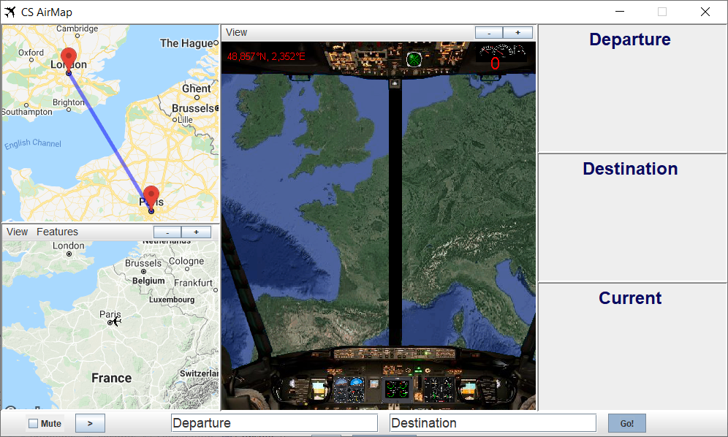
Communication – Start flight :
In the first map, we can now see the route to follow during this flight.
In the second, we can see our current position, and we can zoom in at any time.

Slide 12
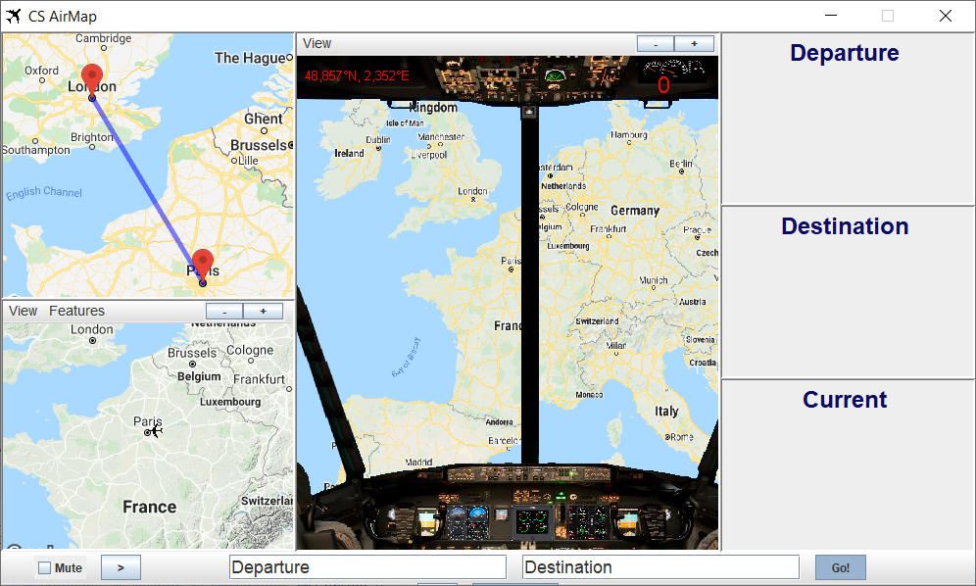
Change the Map:
The interface or the main map will change, showing more details (cities, countries, buildings ... ), according to a GPS.

Slide 13
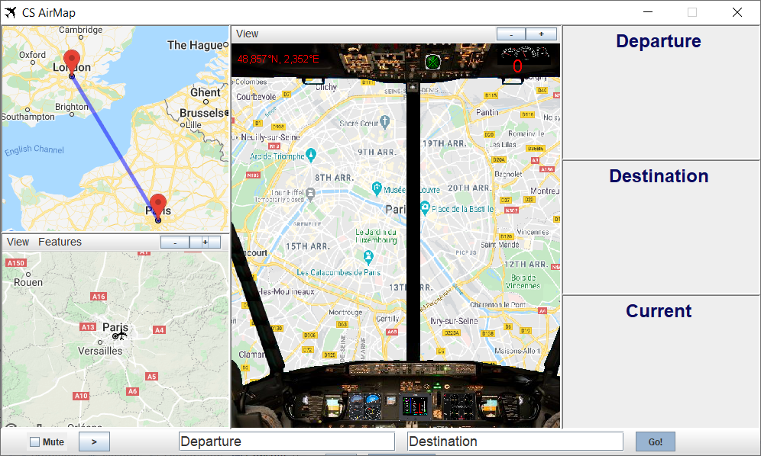
Zoom :
If we zoom in the two maps, as a pilot, we will see more details during the flight, especially the airports that exist in the route
Of course, if you want to benefit from all these features you must have internet and a good connection.

Slide 14
How To control the Traject :
We have now to click on this Button in order to control our flight :

Slide 15
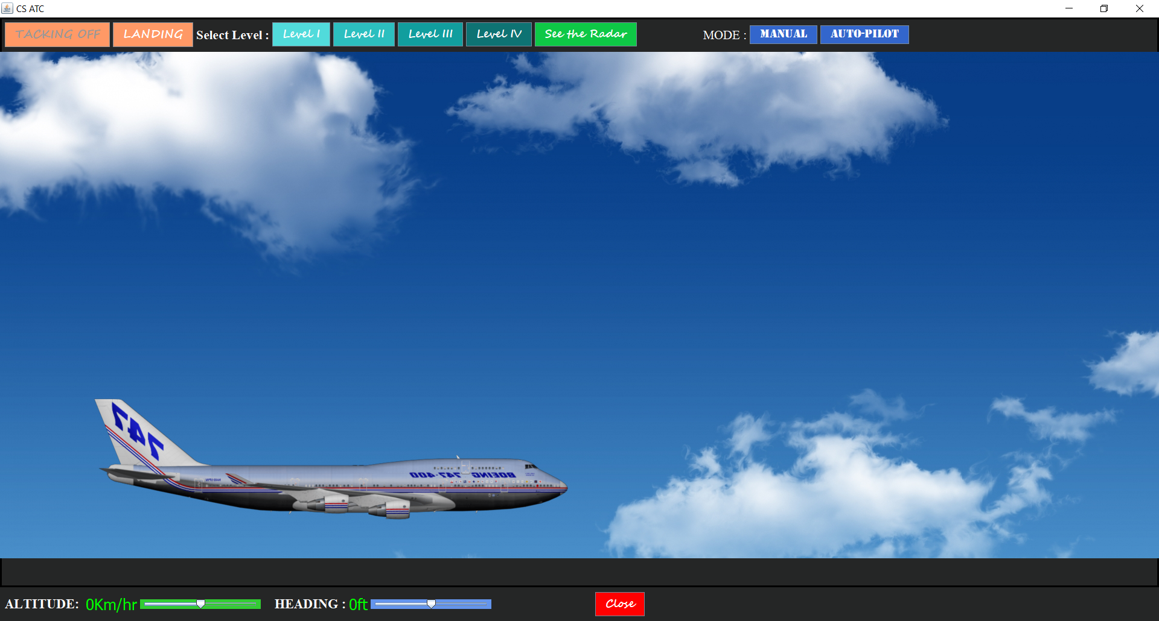
Simple Flight:
Here is the interface that will allow us to control our plane.
It contains buttons for flight levels, the flight mode, the altitude and speed value and a button to view the position in the radar.

Slide 16

Auto-Pilot & Manual :
First, we must choose the flight mode, if we choose Manual mode, automatically the buttons of the Levels will be disabled, otherwise for the Auto-pilot mode they will be activated. The selected mode button is in red.

Slide 17
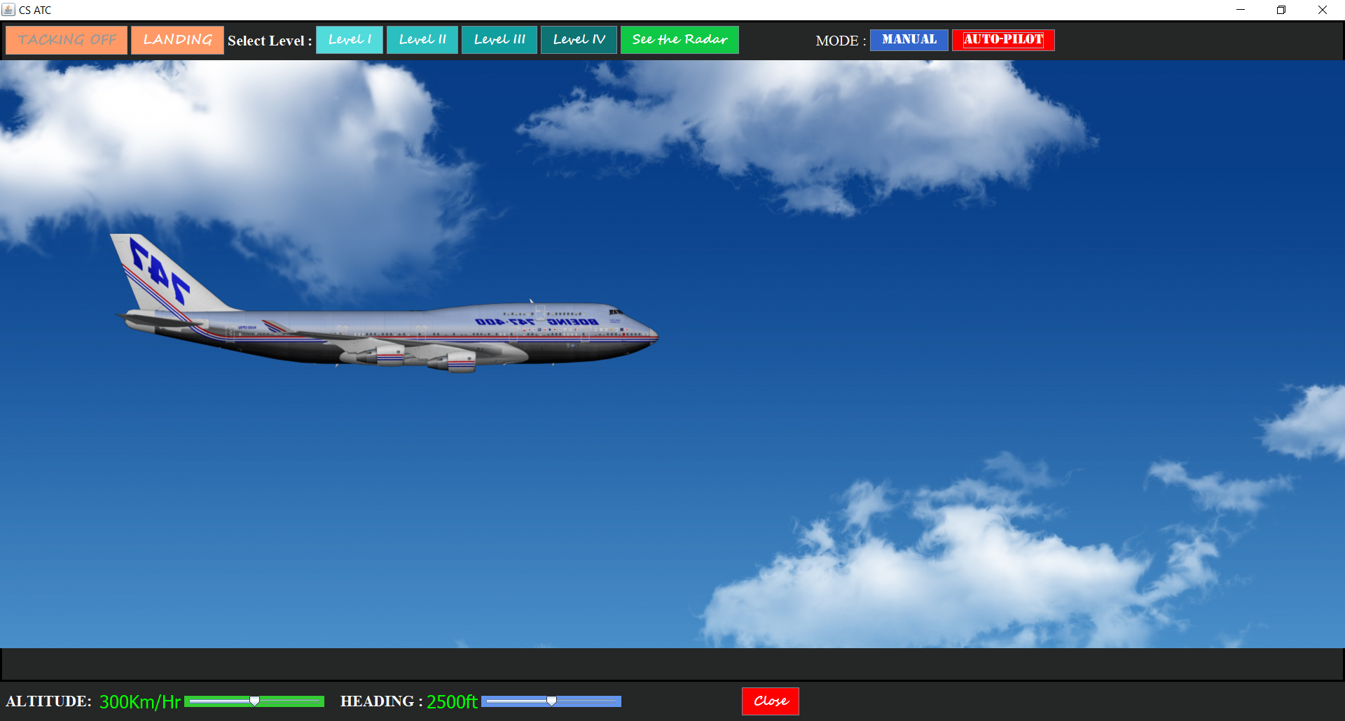
Simple Flight:
If you choose the Auto-pilot mode, you can choose the flight level. For example, if you click on the Level 1 button, you can see the speed level and the altitude of the plane.

Slide 18

Simple Flight:
You can change the flight level, for example, level 4.

Slide 19
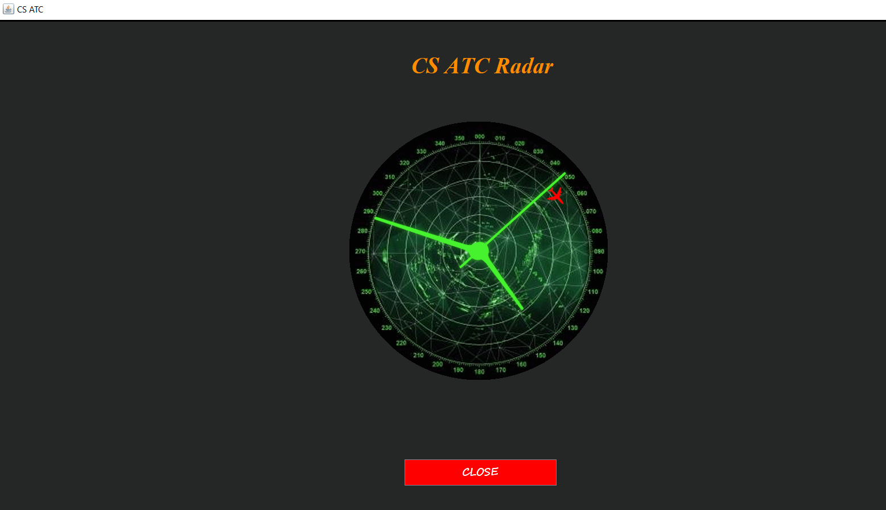
CS Radar :
If we click on the button "See radar", we will see the position of the plane and its movements.

Slide 20
Choose the type of flight !
Let's go back to the interface, type of flight, and choose the type of the helicopter.

Slide 21
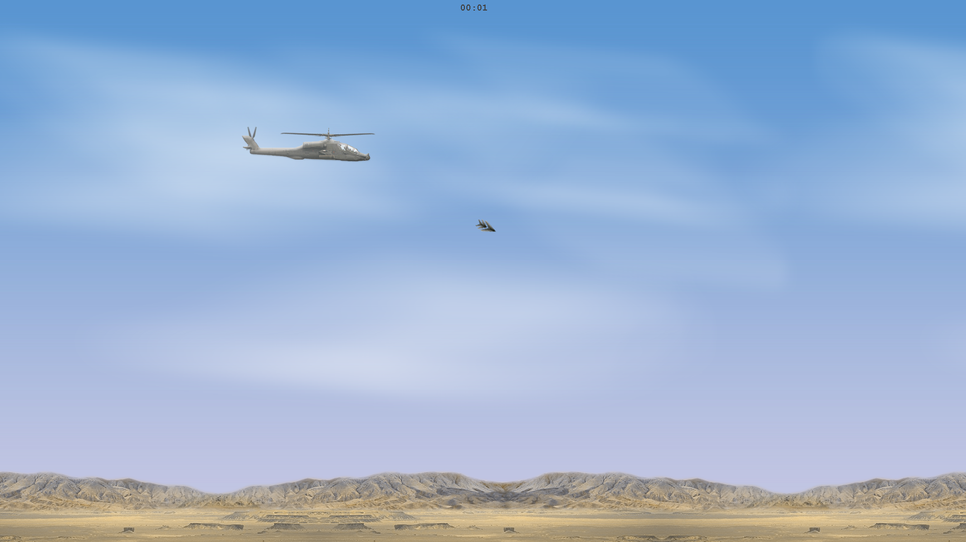
Helicopter:
Here is the helicopter, it's like a game, you can control it manually using the keyboard arrows.

Slide 22
